Slide 1

Notes:
Presenter Reminders:
Mute/Unmute everyone except host (Alt+M)
Speakers – double check that you are sharing screen and sound (if any videos); For PDF, press Ctrl+ L for full screen mode.
Announce transitions (e.g. “We are now moving into the question and answer portion of the presentation, so I will hand it over to the moderators…”)
Claire will keep track of incoming questions and help to moderate Q&A session. Cristina will keep track of meeting room for questions, troubleshooting, etc.
Before the meeting begins, here is the text to enter in the chat box:
Welcome ABGOH! The virtual meeting will begin shortly. Please be sure to mute yourself (Alt + A). We will open the meeting room early to allow for some time to connect/troubleshoot, if needed.
Please use the chat box for questions throughout the presentation, they will be answered during the Q&A portion of the session.
The meeting will begin promptly at 12 (noon).

Slide 2
Agenda
Announcements & Introductions
ABGOH Presentation
  Power of Meaningful Connections:
    Research Overview
    Case Study – National Instruments
    Case Study – University of Texas at Austin
  Questions & Answers
Closing Remarks
Notes:
Claire

Slide 3


Announcements
Thanks for joining!
Mute/Unmute yourself (Alt+A)
Use the chat box for questions
Moderators for today’s meeting include:
Claire Hahn – ABGOH Chair Mary Faria – MHFC Chair
Notes:
Claire
Speaker’s Notes:
Thank you all for joining us today for our ABGOH meeting today.
If you aren’t already, we are going to mute all participants on the call to minimize any background noise. Please be sure to remain muted throughout the entire presentation.
You can utilize the chat box for any questions that you may have. Questions will be held for the end of the presentation. Be sure to send you questions to “Everyone” so the group can see your questions.

Slide 4


THE POWER OF MEANINGFUL CONNECTIONS
Austin Business Group on Health
December 11, 2020

Slide 5

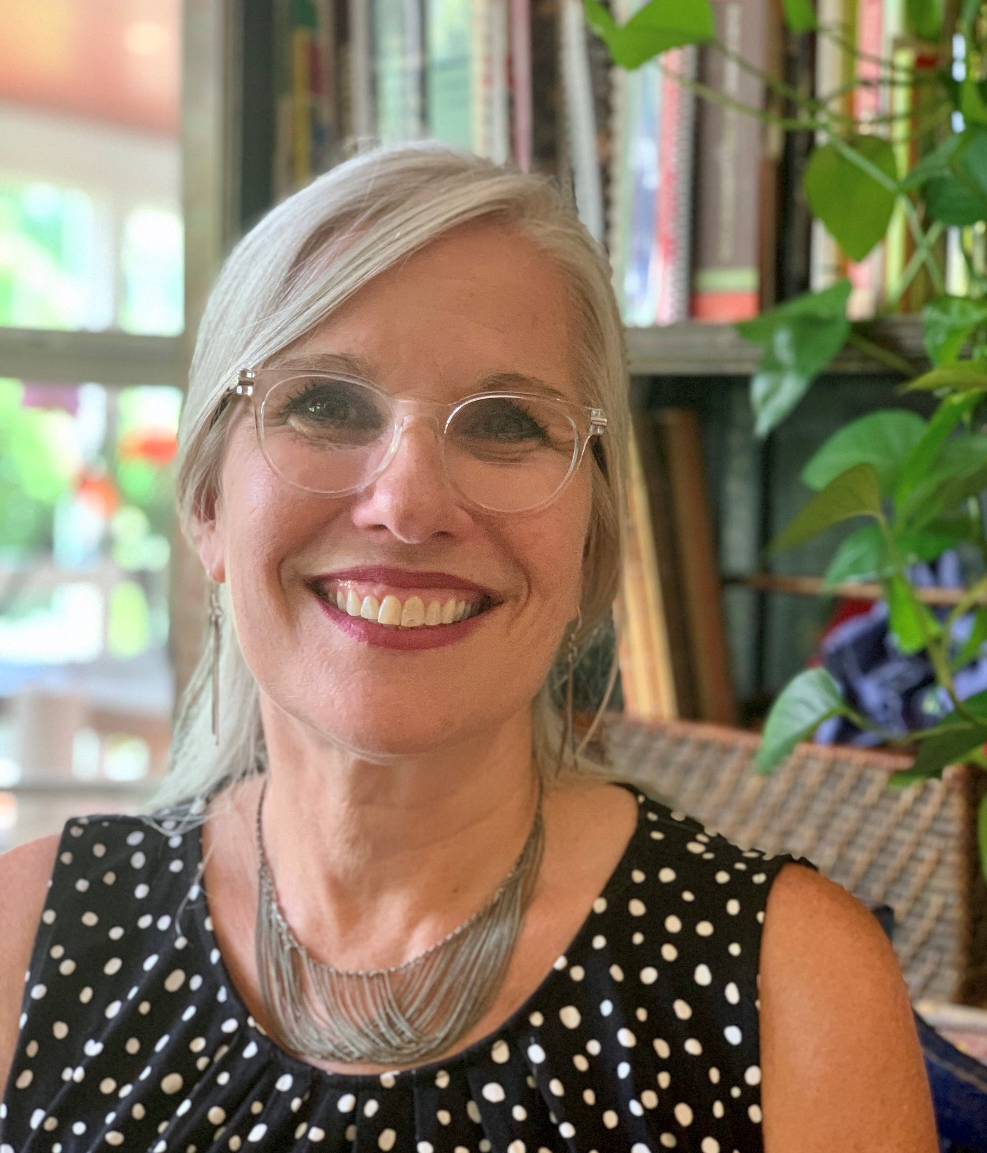
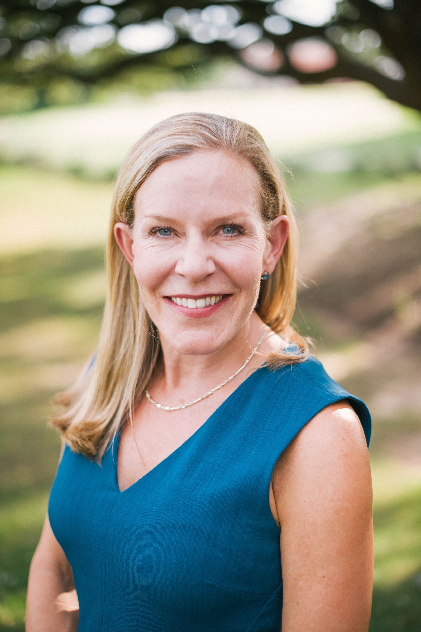
Introducing the Panelists
Susan Thompson, BS Well-Being Program Manager, National Instruments | Susan Harnden, LCSW Director, HealthPoint The University of Texas at Austin | Tre’ McCalister, Ed.D. Founder, McCalister and Associates (MCA)

Slide 6

The Power of Meaningful Connections
Today’s presentation will cover:
A Brief Research Overview: Meaningful Connections at the workplace
Worksite Programming that Build Out Meaningful connections
Summary of key observations
Questions and Answers

Slide 7




Audience Poll
Q: What are you doing today?
“How many of you are incorporating social connections in your wellbeing programs?
Not incorporating opportunities to build out meaningful connections
Currently planning, but not yet implementing social connections
A few programs in place which connect employees, and families
Almost all programs incorporate opportunities to connect employees, team members and families
Chat question:
What are the barriers keeping you from incorporating social connections into your wellbeing programs?

Slide 8
Meaningful Social Connections
The way in which an individual
connects with others physically, behaviorally, cognitively, and emotionally.
1. Structural
“Connection to Others”
(Physical and Behavioral)
2. Functional
“Support and Inclusion”
(Cognitive)
3. Quality
“Sense of Connection”
(Emotional)
Source: Holt-Lunstad, J. (2018). Fostering Social Connection in the Workplace.
American Journal of Health Promotion, 32(5), 1307–1312. (21)

Slide 9
Evidence Linking Strong Social Connections to Better Health
Strong social connections are linked to better physical health⁽¹⁾, higher cognitive functioning⁽²⁾, decreased risk for premature mortality^{(3-5),} longer life expectancy⁽³⁾, improved immune function⁽⁷⁻⁸⁾.
Low Social Connection is a health risk, similar to physical lifestyle risks:
  Smoking 15 cigarettes/day
  Excessive alcohol intake
  >Sedentary lifestyle
  2x’s as harmful as obesity ^{(3,4)}

Slide 10
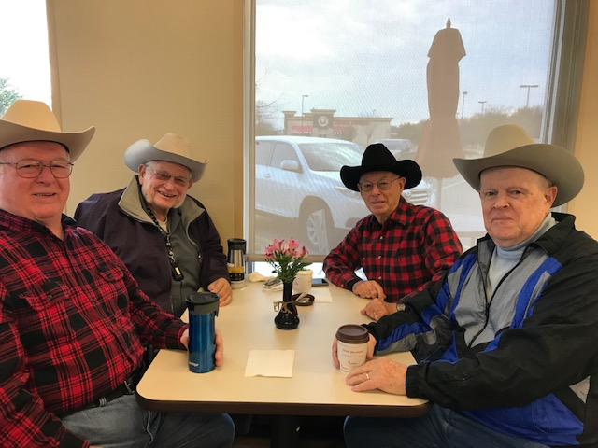
The Power of Meaningful Connections
People with strong social connections are healthier
Report lower stress, anxiety and depression ^{(9, 19)}
Are less likely to catch a cold, (decreased release of cortisol)^{(7,8)}
Have reduced cardiovascular reactivity to stress; heart rate and blood pressure, and lower resting blood pressure^{(5,11,16)}
Live a longer life than those with fewer social connections ^{(3, 4, 14)}

Slide 11
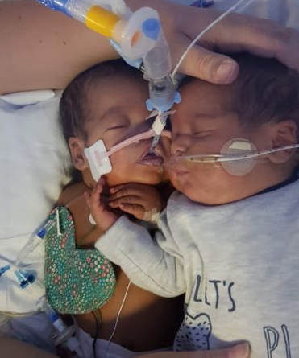
Premature babies cuddle saved twin’s life
Twin boys born 15 weeks early, 25 weeks
Dylan weighed 2lbs while Deiniol was even tinier at just 1lb 9oz.
The smallest twin required 100% oxygen to survive and showed no sign of improvement.
At 14 weeks old, the medical staff felt Deiniol’s wouldn’t survive, so they brought Dylan back to say goodbye.
The twins spent just five minutes together in the incubator, but hours later Deiniol's condition had stabilized, and his oxygen support was reduced to 50%, and eventually he recovered.
BBC News, November 20, 2019
Notes:
https://www.bbc.com/news/uk-wales-50485984
BBC News Story November 20, 2019.

Slide 12

“ We live in the most technologically connected age in the history of civilization, yet rates of loneliness have doubled since the 1980’s….”
-Vivek Murphy
Admiral, USPHS, 19th Surgeon General Of The United States,
(2014-2017)
“ Loneliness Is An Epidemic”

Slide 13
Evidence Supporting the Value of Meaningful Connections in the Workplace
Employees with stronger social connections have lower risk of many significant health problems. This is important for employers because healthy employees tend to have higher levels of work performance, take fewer sick days and bring more energy to the workplace ^{(4, 9,14 , 15)}
High levels of stress at work can lead to absenteeism, illness, low energy, and irritability. By helping employees foster social connections at work, employers can help reduce the effects of workplace stress ^{(21,22)}
Close work friendships boosted employee satisfaction by 50%. People with a ‘best friend’ at work were seven times more likely to be fully engaged in their work ⁽¹²⁾
Social connection provides a sense of cohesion and support at work, which is essential for cultivating creativity, innovation, teamwork, collaboration and an overarching culture of well-being.

Slide 14
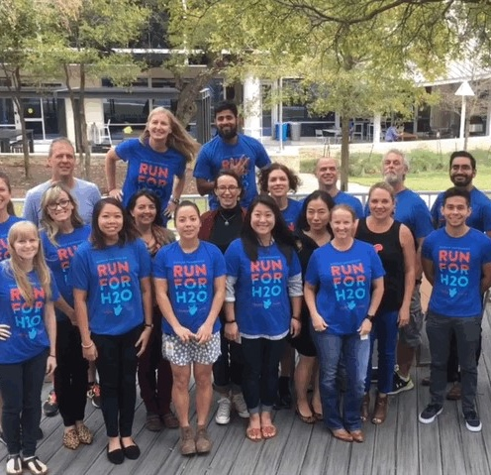
PANELIST #1:
SUSAN THOMPSON, BS
NI

Slide 15

NI is a technology company, located in Austin, TX whose purpose is to “Engineer Ambitiously”.
Wellness programs include a primary care clinic, on site fitness center with recreation courts, 2 miles of wooded, shaded walking trails, newly remodeled cafeteria, outside deck with grills and bocce ball court
NI’s core values:
“Be Bold, Be Kind and Be Connectors”.

Slide 16
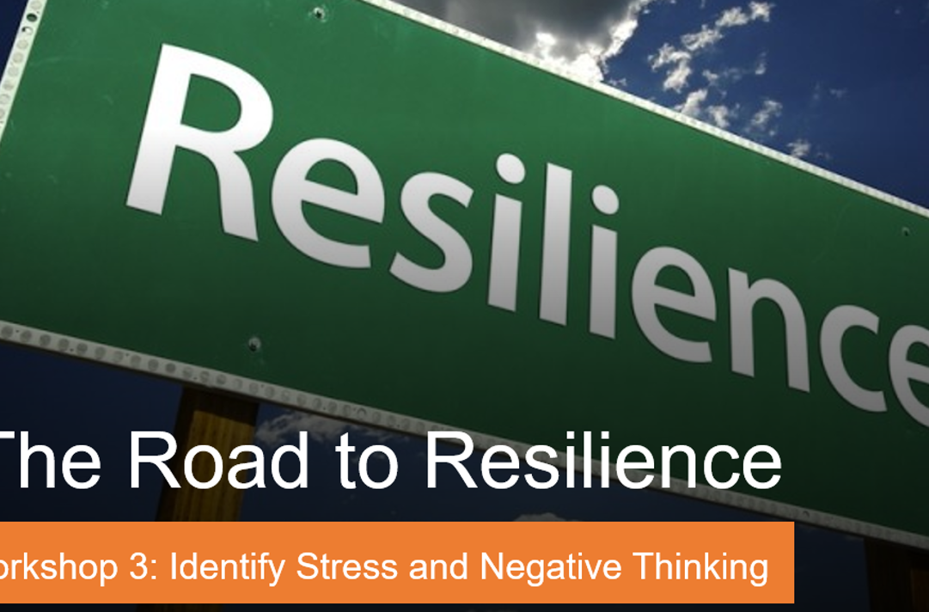
NI
Resiliency Programs
Road to Resiliency
  Program facilitated by health & wellness team
      Gratitude
      Judgement
      Time management and prioritizing well-being habits
      Meditation
      Progressive muscle relaxation
World Meditation Day
      CEO encouraged and kicked off World Meditation Day event in May
"The topics on judgement and planning/time usage were especially helpful and interesting to me. I liked the technique about trying to intercept judgement” – Road to Resiliency participant
Notes:
The new The tie

Slide 17
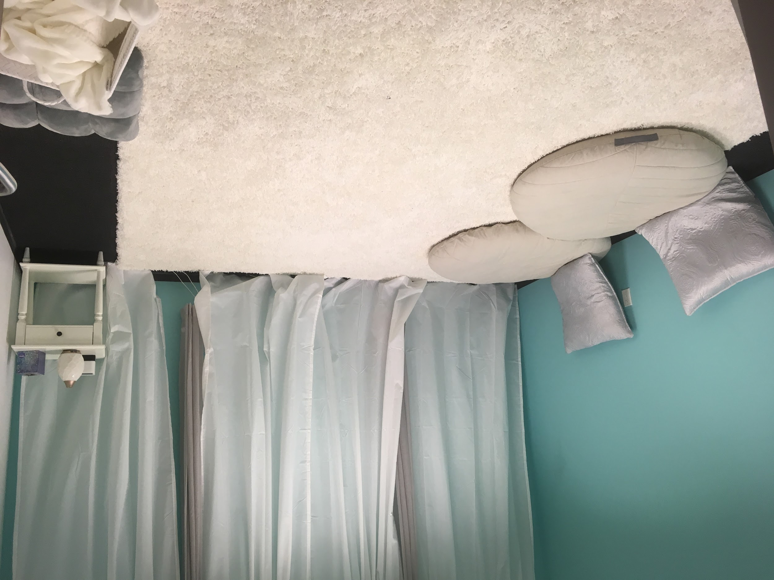

Community Connections & Wellness Programs
Workday Wind Down
Challenge: Employees are having a hard time separating work life balance
Solution: Workday Wind Down
Employees report feeling better, relaxed and ready to quit or take a break from work.
Mindfulness Rooms on campus
encourage employees to make a mindfulness space at home

Slide 18
NI Wellness Retreat
 | Event | Description
 | The Productive Office Hosted by: Beverly Biehl | Beverly Biehl, owner of The Intuitive Interior, will teach NIers how to incorporate Feng Shui into their homes.
 | When Life Hands You a Pandemic Hosted by: Art Markman | Professor of Psychology and Marketing at the University of Texas. Art Markman recently published the book “Bring Your Brain to Work” and will be speaking from this – discussing Values Systems and how the influence happiness in the workplace.
 | Family Cooking Class Hosted by: Rachel Zierzow | Rachel Zierzow will teach a family-friendly cooking class on how to Cook Naturally without a recipe.
 | Unwind Your Day with Career Zen Hosted by: Lynn Chang, Ph.D. | Wellness Presentation focusing on relaxation, nourishment, energy – as well as hosting a “Workday Wind Down” Yoga Flow.
 | Picked Apples, Whaa? Hosted by: Stephanie McClenny | Stephanie McClenny, owner of Confituras in Austin, TX will teach a family-friendly pickling workshop.
Part of employee appreciation week
Interactive sessions
Feng shui for your office,
  Cooking class for families
  Interactive stress relief with meditation and yoga
Interactive sessions
500+ participants with positive feedback on all sessions

Slide 19
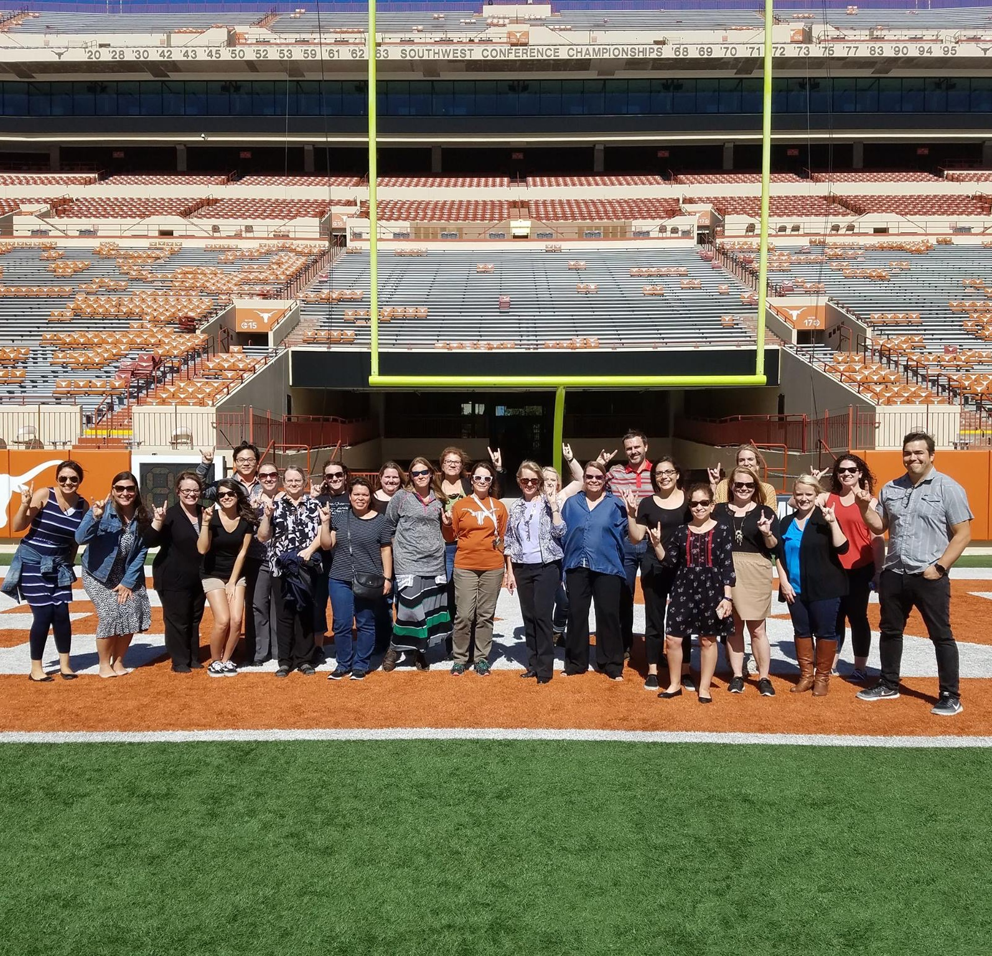



PANELIST #2:
SUSAN HARNDEN, LCSW, CEAP
THE UNIVERSITY OF TEXAS AT AUSTIN

Slide 20



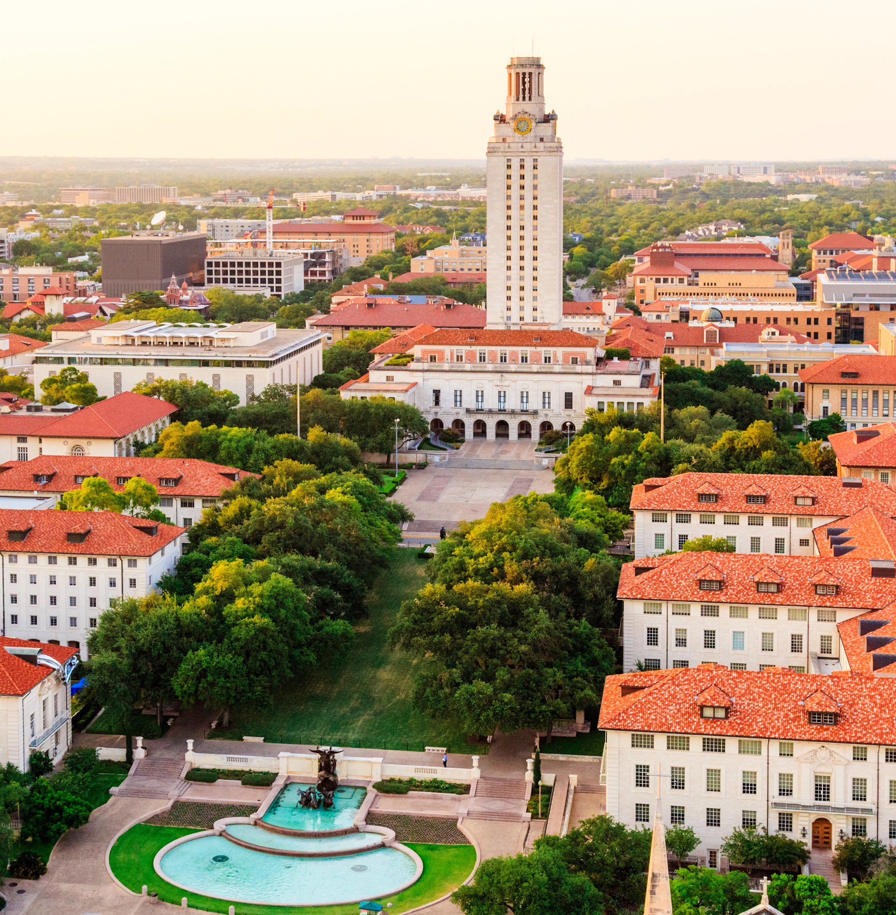
The University of Texas at Austin
          Wellness and Work/Life
          Employee Assistance Program Occupational Health Program

Slide 21
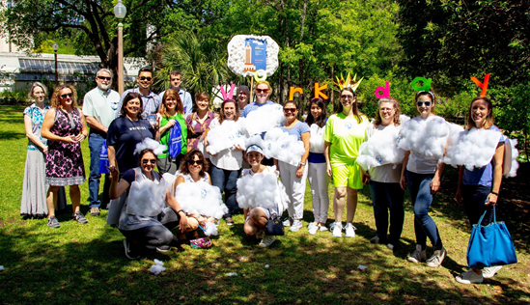

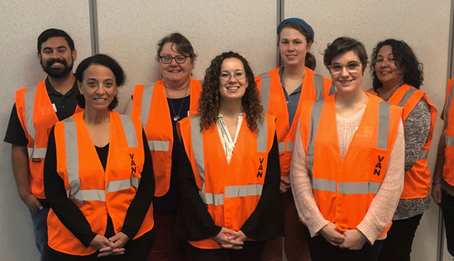
Longhorns Connect
  Affinity Groups
  Orange Santa
  UT Remembers
  Victim’s Advocate Network (VAN)
  Staff Emergency Fund
  Succulent Socials

Slide 22
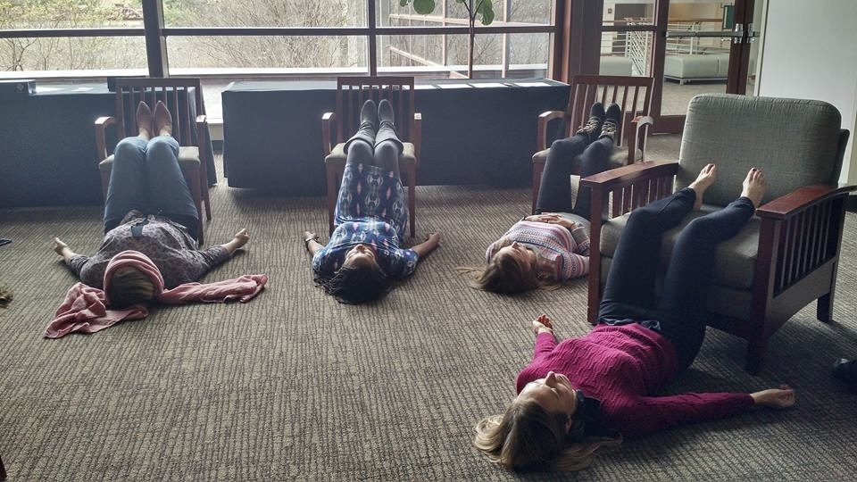

Wellness Champions
Ambassadors Promoting a Vision for a Healthy Campus
Communication
Ongoing Wellness Learning
Networking
Funding

Slide 23
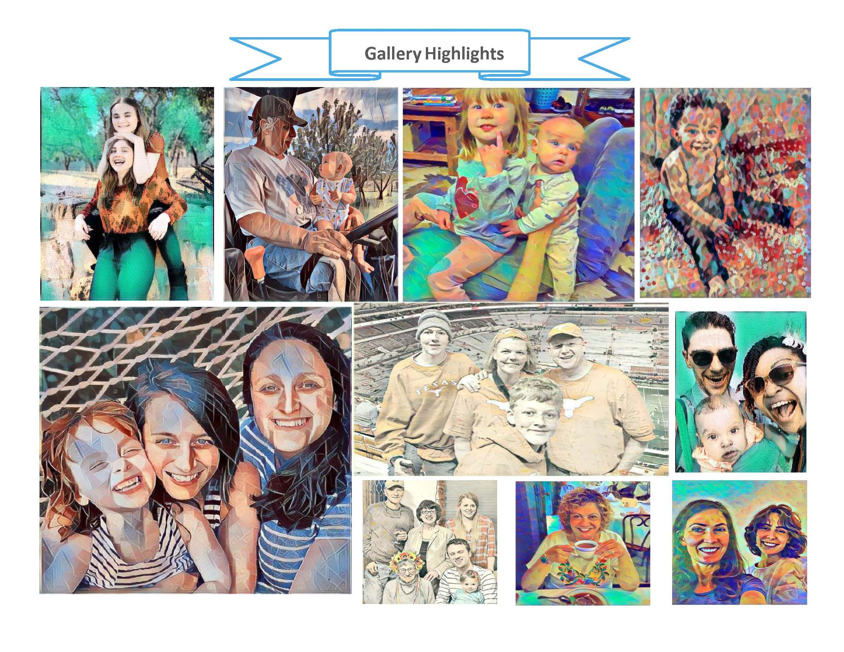

Work of Art – 2020 Challenge
Activity Challenges
Multiple Challenges a Year
  Campuses compete
  Employees create teams
  Special events
    Bowling kick-off party
    Wellness Scavenger Hunt
    Celebration Luncheon
    Exercise classes
    Weekly prize drawings
"The friendship during the pandemic was definitely great. But without that situation,
it's creating something and embracing a
strong emotional wellbeing"

Slide 24

Interactive Chat
“Ideas in a minute”:
Share a brief example of how you have developed programs to foster "meaningful connections” at your worksite.
If you are incorporating opportunities to connect employees, team members and families through your well-being programs… what is working for you?

Slide 25

Panel Recap:
Common Themes
Leveraging wellness program delivery to keep employees “connected”
“Managing stress and enhancing resilience” while ”keeping employees active and healthy”
Proactive outreach to hard to reach, at risk, and diverse populations
Encouraging employees to connect in their community through volunteerism
Establishing tools for champions, leaders and worksites to provide a supportive work environment
Building out family friendly practices to support flexibility, work and life

Slide 26
QUESTIONS?

Slide 27
References
Uchino, BN . Social support and health: a review of physiological processes potentially underlying links to disease outcomes. J Behav Med. 2006;29(4):377–387.
Boss, L, Kang, D-H, Branson, S. Loneliness and cognitive function in the older adult: a systematic review. Int Psychogeriatr. 2015;27(4):541–553..
Holt-Lunstad, J, Smith, TB, Layton, JB. Social relationships and mortality risk: a meta-analytic review. Med. 2010;7(7).
Holt-Lunstad, J, Smith, TB, Baker, M, Harris, T, Stephenson, D. Loneliness and social isolation as risk factors for mortality: a meta-analytic review. Perspect Psychol Sci J Assoc Psychol Sci. 2015;10(2):227–237.
House, J, Landis, K, Umberson, D. Social relationships and health. Science. 1988;241(4865):540–545.
Béland, F, Zunzunegui, M-V, Alvarado, B, Otero, A, Del Ser, T. Trajectories of cognitive decline and social relations. J Gerontol B Psychol Sci Soc Sci. 2005;60(6):P320–P330.
Robles, TF . Stress, social support, and delayed skin barrier recovery. Psychosom Med. 2007;69(8):807–815.
Cohen, S., et. al, (2020) Psychosocial Vulnerabilities to Upper Respiratory Infectious Illness: Implications for Susceptibility to Coronavirus Disease 2019 (COVID-19).
Santini ZI, Jose PE, York Cornwell E, et al. Social disconnectedness, perceived isolation, and symptoms of depression and anxiety among older Americans (NSHAP): a longitudinal mediation analysis. Lancet Public Health. 2020;5(1):e62-e70.
Lindsay EK, Young S, Brown KW. Mindfulness training reduces loneliness and increases social contact in a randomized controlled trial. Proc Natl Acad Sci. 2019;116:3488–3493.
Fredrickson BL, Cohn MA, Coffey KA. Open hearts build lives: positive emotions, induced through loving-kindness meditation, build consequential personal resources. J Pers Soc Psychol. 2008;95:1045–1062. doi: 10.1037/a0013262. PMC3156028. [Wellness Programs Don’t Do for Workers, Charlotte Lieberman. August 14, 2019. https://hbr.org/2019/08/what-wellness-programs-dont-do-for-workers
https://depts.washington.edu/hprc/evidence-based-programs/connect-to-wellness/
https://www.forbes.com/sites/nazbeheshti/2019/01/16/10-timely-statistics-about-the-connection-between-employee-engagement-and-wellness/#70daab9322a0
Steptoe, A., Shankar, A., Demakakos, P., & Wardle, J. (2013). Social isolation, loneliness, and all-cause mortality in older men and women. Proceedings of the National Academy of Sciences, 110, 5797–5801.
Thomas K M Cudjoe, MD, MPH, David L Roth, PhD, Sarah L Szanton, PhD, Jennifer L Wolff, PhD, Cynthia M Boyd, MD, MPH, Roland J Thorpe, Jr, PhD, The Epidemiology of Social Isolation: National Health and Aging Trends Study, The Journals of Gerontology: Series B, Volume 75, Issue 1, January 2020, Pages 107–113, https://doi.org/10.1093/geronb/gby037
Teresa Seeman et al., “The Great Recession Worsened Blood Pressure and Blood Glucose Levels in American Adults,” Proceedings of the National Academy of Sciences 115, no. 13 (2018): 3296-301.[9] U.S. Census Bureau, 2018 American Community Survey.
“New Cigna Study Reveals Loneliness at Epidemic Levels in America,” PRNewsWire, May 1, 2018, https://www.prnewswire.com/news-releases/new-cigna-study-reveals-loneliness-at-epidemic-levels-in-america-300639747.html
Gallup, State of the American Workplace, 2017, p. 118, https://www.gallup.com/workplace/238085/state-american-workplace-report-2017.aspx
Thoits PA. Mechanisms linking social ties and support to physical and mental health. Journal of Health and Social Behavior. 2011;52:145.
Mayoclinic, August 24, 2019: https://www.mayoclinic.org/healthy-lifestyle/adult-health/in-depth/friendships/art-20044860
Holt-Lunstad, J. Fostering Social Connection in the Workplace. American Journal of Health Promotion, 2018; 32(5), 1307–1312.
Chen L, Hannon PA, Laing SS, et al. Perceived workplace health support is associated with employee productivity. Am J Health Promot. 2015; 29(3):139-146.
McCalister, K.T., Dolbier, C.L., Webster, J.A., Mallon, M.W. and Steinhardt, M.A. Hardiness and Support at Work as Predictors of Work Stress and Job Satisfaction. Am J Health Promot. 2006; 20(3), 183-191.
Steinhardt, M.A., Dolbier, C.L., Gottlieb, N.H. and McCalister, K.T. The Relationship between hardiness, Supervisor Support, Group Cohesion, and Job Stress as Predictors of Job Satisfaction. Am J Health Promot. 2003; 17:382-380.

Slide 28
Thank you for joining us !
For additional information contact Tre’ McCalister at: tre.mccalister@mccalisterandassociates.com
Additional Meaningful Connections resources at http://mccalisterandassociates.com/

Slide 29

A word from our Sponsor:
 | Shelly Davis Obesity Educator seyd@novonordisk.com
Notes:
Claire
Speaker’s Notes:

Slide 30

Announcements
Thank you to our speakers – Tre’, Susan, Susan!
Thank you to our meeting sponsor Novo Nordisk.
Today’s presentation will be posted to the MHFC website.
Session evaluation in the chat box.
Wishing you a happy & healthy holiday season!
Notes:
Mary
Speaker’s Notes:
Thank you to wonderful presenter/sponsor.
Today’s presentation will be posted to the MHFC website within the next couple of days.
Please take a moment to complete the session evaluation that you can find in the chat box.
The next ABGOH meeting will be in early spring 2021 and will be announced via email and posted on the MHFC website.

